Slide 1
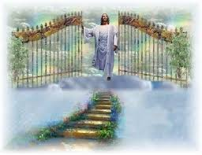
人生的福
Blessings

Slide 2
人生一切能享的福 哪样保留得住 人生一切能享的福 哪样不虚空
人生的福 Blessings
Everything you enjoy in life
which one can be kept?
Everything you enjoy in life
which one is not empty?

Slide 3
人生一切能享的福 哪样能够满足 人生一切能享的福 哪样能带走
人生的福 Blessings
Everything you enjoy in life
which one can satisfy you?
Everything you enjoy in life
which one can you take with you?

Slide 4
我愿给你最好礼物 就是主基督 胜过你人生一切的福 最深的羡慕
人生的福 Blessings
The best gift I can give you
is the Lord Christ
This is better than all the blessings of your life
my deepest admire

Slide 5
你能给我最好的礼物 是信主基督 跟随他脚步永远有福 我最深的喜悦和欢呼
人生的福 Blessings
The best gift you can give me is to believe in Christ.
always follow his footsteps and have blessings forever
my deepest joy and cheer

Slide 6
你能给我最好的礼物 是信主基督 跟随他脚步永远有福 我最深的喜悦和欢呼
人生的福 Blessings
The best gift you can give me is to believe in Christ.
always follow his footsteps and have blessings forever
my deepest joy and cheer

